Slide 1

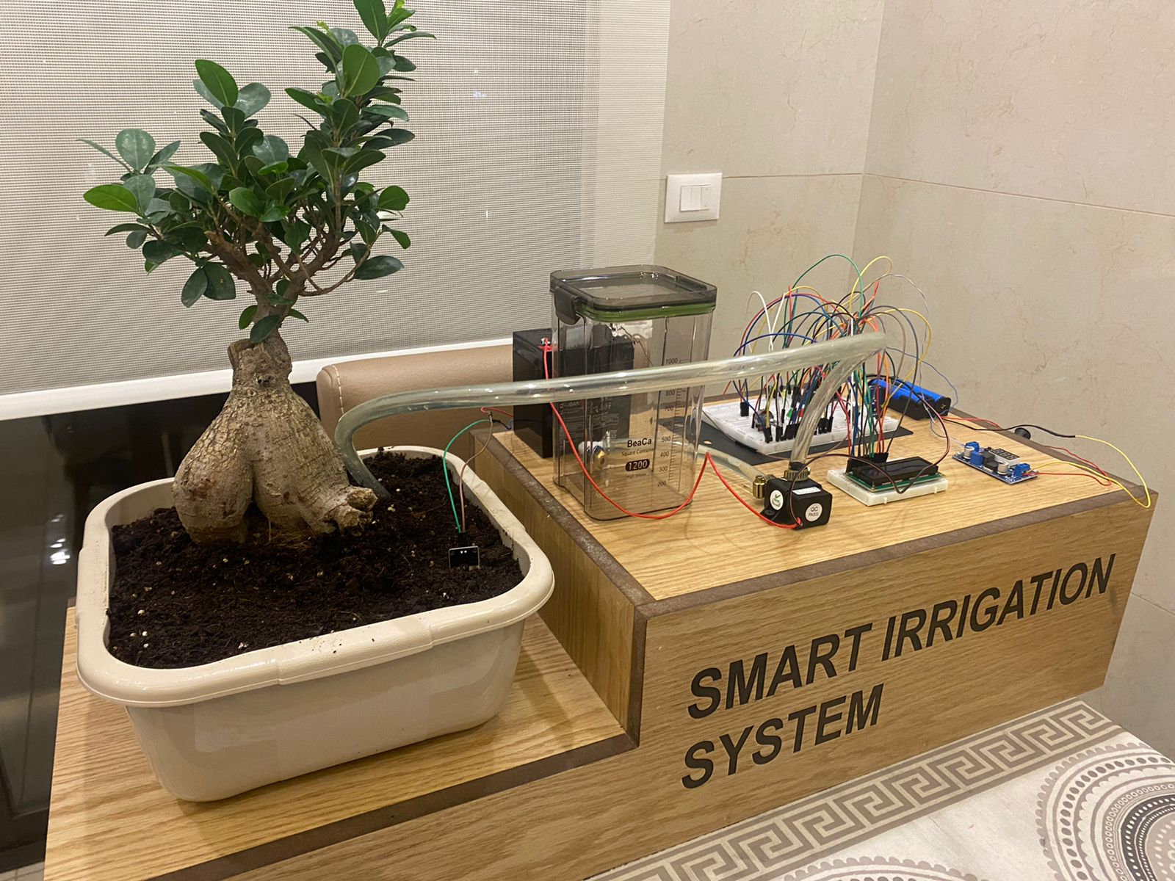
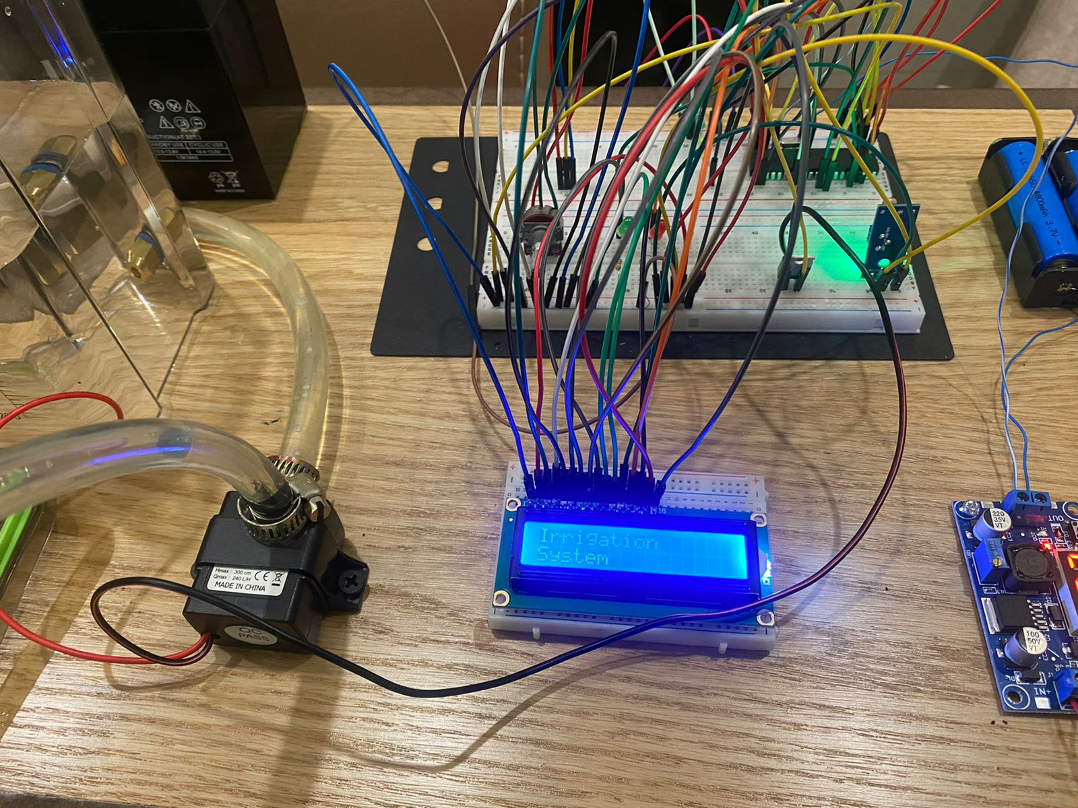
Smart Irrigation System
T. Sulaiman, and I. Karaman
Supervisor: Dr. Anastasia Algharib
Embedded Systems Final Design Project, Fall 2024
King Abdullah II School of Engineering
Princess Sumaya University for Technology
Introduction
The Smart Irrigation System project aims to create an efficient irrigation system using a PIC16F877A microcontroller programmed in C. It monitors temperature and humidity, activating a water pump based on these values for plant irrigation. The system also displays its status on an LCD. Input sensors include temperature, humidity, and light sensors, with output components consisting of a water pump and LEDs. This project offers a concise and effective solution for smart irrigation.
Results
The system works well, accurately measuring temperature, humidity, and light. It adjusts the pump's operation based on the temperature threshold using Pulse Width Modulation (PWM). This means it can control how long and fast the pump works to match the temperature conditions. The humidity sensor helps prevent over-watering, and the light sensor ensures the system responds appropriately to different lighting conditions. The LCD display provides real-time information about the system's status, making it user-friendly. Overall, the system is effective in smart and efficient irrigation, adapting to environmental factors for optimal plant health and resource conservation.
Figure 2: Project front view
Once the sensor readings are obtained, a comparison is made with predefined thresholds. Depending on these readings, if the temperature threshold is reached, the pump operates for 5 seconds at half-speed PWM, followed by 5 seconds at full speed. In the case of low humidity, the pump operates at full speed for 10 seconds. If the lighting conditions are detected as dark, the LED is turned on for 5 seconds.
Figure 3: Project top view
Design
start
Initialize values and
variables
Configure ports and
modules
LCD ON displaying
"Irrigation System"
Enter While loop
Read values from
Light , temperaure
and Humidity sensors
False
True
Temp value > tempthreshold
True
False
Water pump ON
Low humidity ?
Green led ON
LCD ON
Water pump ON
True
False
Green led ON
Dark ( no light) ?
Delay 10 sec
LCD ON
LED ON
Delay 10 sec
LCD ON
Delay 10 sec
Figure 1: Flow chart
Conclusion
In conclusion, the Smart Irrigation System represents a sophisticated and streamlined solution for precision plant irrigation. By leveraging the capabilities of the PIC16F877A microcontroller and utilizing input sensors such as temperature, humidity, and light sensors, the system effectively responds to environmental conditions. The seamless integration of these components allows for the activation of a water pump and the illumination of LEDs, ensuring optimal plant care. The inclusion of a user-friendly LCD display enhances the system's accessibility and transparency. Overall, this project exemplifies a comprehensive and efficient approach to smart irrigation, contributing to the advancement of automated agricultural practices.

